Slide 1
Lab 02
Raspberry PI microcontroller

Slide 2
practical applications of ultrasonic sensors with Raspberry Pi
Board Overview: Understanding the Raspberry Pi pins and their functions.
GPIO Pins: Learning how to use General Purpose Input Output (GPIO) pins.
Interfacing I/O Devices: Connecting and controlling simple devices like LEDs and ultrasonic sensors.
Ultrasonic Sensor: Understanding its working principle and interfacing it with Raspberry Pi.
Distance Measurement: Using an ultrasonic sensor to measure distance accurately.

Slide 3
Materials
Raspberry PI development board
LED (Light Emitting Diode)
Ultrasonic Sensor(HC-SR04)
Resistor (appropriate value for current limiting, typically around 220 ohms)
Jumper wires
Breadboard
USB pen drive containing OS

Slide 4
1. Raspberry PI
small, affordable, and powerful single-board computer.
Allows interfacing with sensors, motors, and other hardware.
Includes USB ports, HDMI, WiFi, Bluetooth, and Ethernet (depending on the model).
Compatible with languages like Python, C, and Scratch

Slide 5
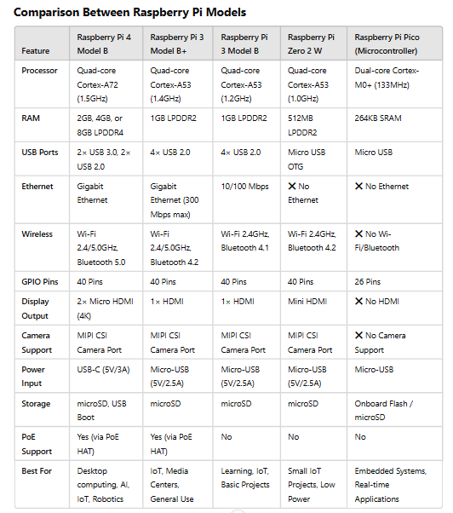

Slide 6
Raspberry Pi 4 Model B
Fast Processor: It has a 64-bit quad-core processor, making it much faster than previous models.
Supports Two Screens: You can connect two monitors using its micro HDMI ports, with up to 4K resolution.
High-Quality Video: It can play 4K videos smoothly.
More RAM Options: Comes with up to 8GB of RAM, so it can handle bigger tasks.
Strong Wireless Connection: Supports WiFi (2.4GHz & 5.0GHz) and Bluetooth 5.0 for fast connectivity.
Fast Internet & USB: Has a Gigabit Ethernet port for wired internet and USB 3.0 ports for fast data transfer.
Power Over Ethernet (PoE): Can be powered via a network cable using an extra PoE HAT accessory.

Slide 7
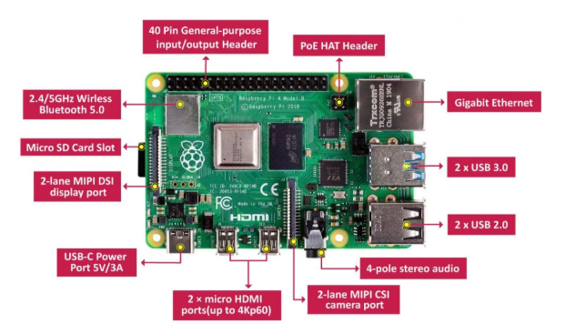

Slide 8
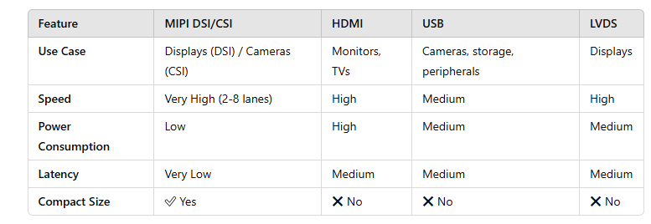
MIPI Compares to Other Interfaces

Slide 9
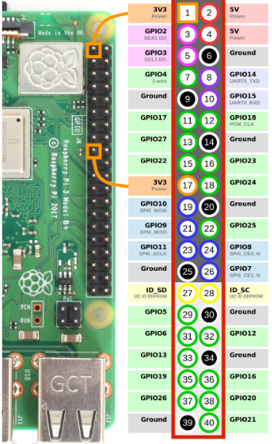
GPIO header: 40 pins
Power Pins:
Provide 3.3V or 5V power
Ground (GND) Pins:
Needed to complete a circuit
GPIO (General Purpose Input/Output) Pins:
Used to connect and control devices
Special Function Pins:
communication protocols like I2C, SPI, UART

Slide 10
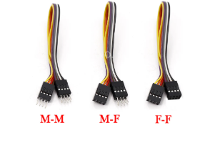
2. Jumper wires

Slide 11
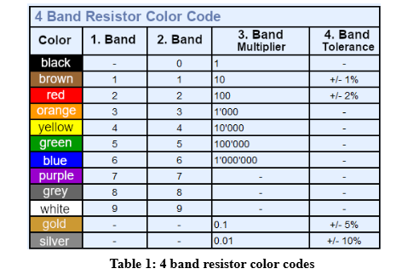
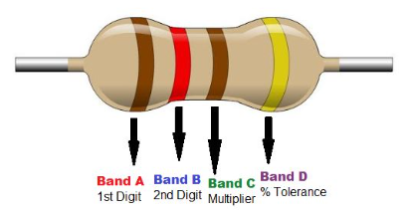
3. Resistors

Slide 12

4. Ultrasonic Sensor
a device that measures distance by using sound waves.
It works like a bat’s echolocation
sending out ultrasonic pulses(sound waves)
measuring how long they take to bounce back.

Slide 13
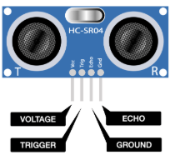
Ultrasonic Sensor (HC-SR04) Pin Explanation
Pin 1 (VCC) → Power Pin
Connect this to 5V to power the sensor.
Pin 2 (Trigger) → Start Measurement
Send a small signal (keeping the pin HIGH for 10 microseconds)
to make the sensor send out sound waves — input
Pin 4 (Echo) → Receives the Signal
This pin turns HIGH when the sound wave bounces back.
The time it stays HIGH tells how far the object is.
Pin 3 (GND) → Ground Pin
Connect this to the GND of your system to complete the circuit.

Slide 14
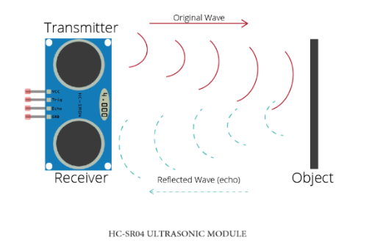
Working mechanism of an ultrasonic sensor
Sending the Sound Wave (Trigger Signal)
The sound wave moves forward
until it hits an object.
Then, the wave bounces back
toward the sensor.
The receiver detects the returning sound wave.
The Echo pin goes HIGH when the sensor receives the reflected sound.

Slide 15
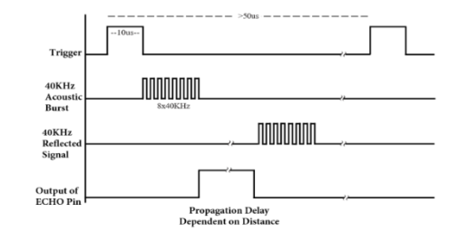
Working mechanism of an ultrasonic sensor
Trigger pin is set HIGH (turned ON) for at 10 microseconds (µs).
tells the sensor to send 8 pulses of 40kHz ultrasonic sound.
The sensor generates 8 short sound waves at 40 kHz.
These waves travel forward, hit an object, and bounce back.
When the sound wave returns to the sensor, Echo pin goes HIGH.
The time between sending and receiving the wave determines the distance
The Echo pin stays HIGH for the amount of time the sound wave took to travel to the object and back.
This time is called Propagation Delay

